Slide 1
The United Kingdom at Work
If you would like to see the complete presentation, then please use the website contact sheet or call me on +44 (0) 7836 247 813
Martin Bartholomew
1 Jan 2016

Slide 2
Contents
Social, historical and political context
Work and business environment,
Relationship building
Meetings
Leadership
Teams
Feedback
Decision making

Slide 3
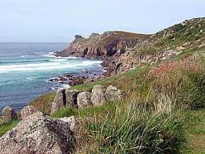
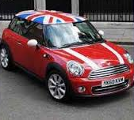
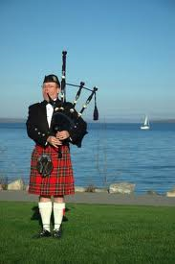
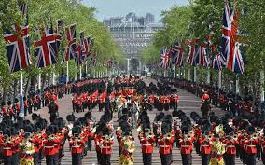
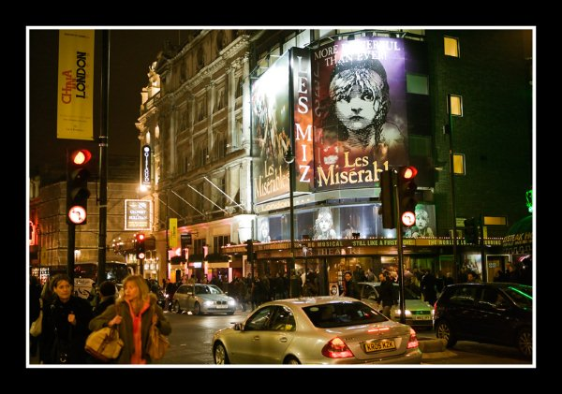
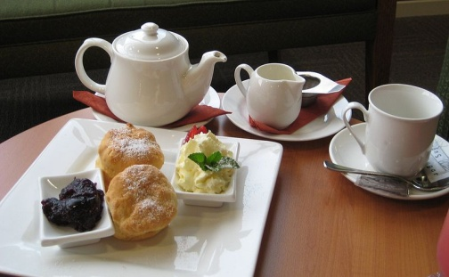
Some Images of British Life
Notes:
Tradition, history and scenery. The vibrant City of London, financial services, hi-tech inventive/creative industries and clusters. Fashion, culture. Multi-culture and tolerance. Football.

Slide 4
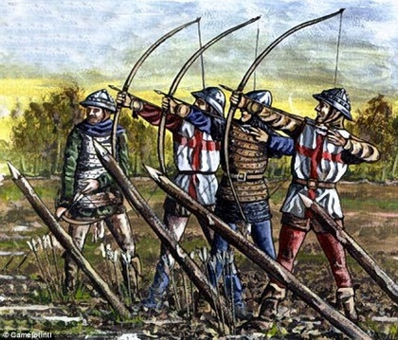
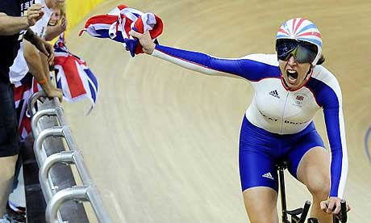
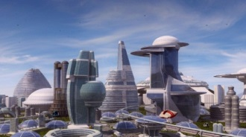
Our history
1000-1700: Forming the British nation: Anglo-Saxons/Vikings, Danes, Normans, Scots, Welsh, Irish. Sovereignty transferred from Crown to Parliament. “Bill of Rights”.
1700–1900: 1707 Act of Union (England & Scotland). Industrial Revolution. Huge Empire. Many, many inventions – and still today. “To be born an Englishman is to win the lottery of life”.
1900 -1975: European turmoil, world conflict, loss of Empire and real power. (Ireland home rule from 1922) Industrial decline/especially in terms of jobs. Welfare State. Accession to EC 1973
1975-2025: UK becoming comfortable in its new identity(ies) and role in the World community. English language. Financial globalisation. Wars! Multi-cultural, tolerant & increasingly secular. Creative excellence. Olympics 2012 Opening Ceremony (according to NY Times): Britain presented itself a nation secure in its own post-empire identity, whatever that actually is...
2050: ??
Notes:
England and Scotland: Crowns merged since 1603. 1707 “Hostile merger that became a full partnership in the most powerful going concern in the World.” (Simon Schama)
1975-2025
“The Welfare State”. Left of Centre? Right of Centre? The Trade Union era.
Economic and social transformation (Margaret Thatcher 1979-1990). The cults of the individual and of “celebrity”
Evolution of the UK towards “multicultural and devolved”.
London with its financial services. Edinburgh and other prosperous cities outside London. Knowledge clusters: London, Cambridge, Oxford, Manchester, Leeds, Edinburgh Some depressed regions – especially in the North.
English language as a driver of UK’s prosperity. Finance, design, media, fashion/pop/music capital of Europe – maybe the World. High value engineering. Tolerance. Equality. Freedom of speech. Social Safety. (but also Dependancy).
2012 Summer of the Olympics
Sarah Lyall, The New York Times:
"Britain presented itself to the world Friday night as something it has often struggled to express even to itself: a nation secure in its own post-empire identity, whatever that actually is... It was neither a nostalgic sweep through the past nor a bold vision of a brave new future. Rather, it was a sometimes slightly insane portrait of a country that has changed almost beyond measure since the last time it hosted the Games, in the grim post-war summer of 1948."

Slide 5
UK political context
“Right-of-centre market economy with left-of-centre social justice.”
UK derives historically from an “England/London-centric” power base - with certain powers grudgingly devolved. (N.b Scotland., Wales, English regions. Historically: Ireland.
USA, Australia (for example) derive from individual “State” power bases –with certain powers willingly passed upwards.
Strong sense of history. We used to be an empire. – we used to be mass manufacturers.
Economy growing. Very strong on financial services, creative industries, high technology/high value engineering. “Brits” in London come from all over the World.
Proud of our values – often people think we are too tolerant of the values of others.
Critical issues for UK
Skill shortages. UK population getting older and fatter – need immigration
National debt reduction. Moving from annual deficit to neutrality over the economic cycle.
Current political rhetoric: a country for “working people”
Our place in the wider World, especially the EU (NOT the Eurozone!)
Notes:
Expansion of infrastructure – London Airports, High speed rail. Takes a long time to get projects agreed.

Slide 6
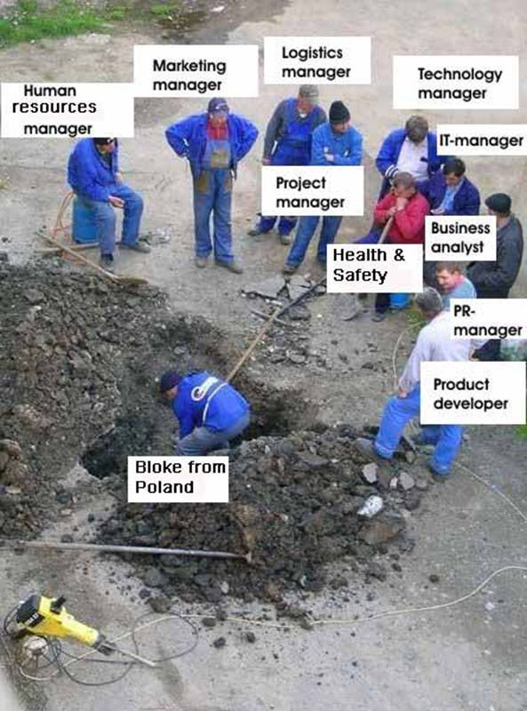
A lot of irony in British language and humour
Decoding the English language
See attached guide!

Slide 7
Communication in UK
Indirect/subtle speech:
Strategy: Decode with humour
Process/gradualness/courtesy:
Strategy: Be polite and patient, but also ensure that teams include some action-oriented people!
“Since I came to UK from Norway, I spend three times as long writing my emails”
Wanting context/explanation and a chance to be creative:
Strategy: Describe issues calmly, and ask for opinions before making a decision
Notes:
Indirect/subtle speech: humour, irony, round-about speech patterns, understatement. Apparently casual and undemonstrative interaction. Northerners and Scots more direct than Southern English, Welsh and Irish a bit more romantic. (Strategy: Decode with humour)
Process/courtesy: protocol, gradualness, fairness, avoiding conflict, compromise (“fudge”). Since I came to UK from Norway, I spend three times as long writing my emails”. (Strategy: Be punctual, polite, correct and patient, but also ensure that teams include some action-oriented people!)”
Wanting context/explanation and a chance to be creative: (Strategy: Describe issues calmly, and ask for opinions before making a decision)

Slide 8
Relationship building
With people you meet at work, and in every day life :
UK is a “persuasion” culture. Avoid direct orders/instructions when you can, or “in your face” emails.
People will react better when you use indirect sounding suggestions, and even questions.
With individuals, be cautious about direct personal questions - ask gentle, neutral questions and build up a picture slowly.
Be on time. Don’t boast
Get a mentor/mentors - including “cultural mentor(s)”
Go to the pub. Find out who the opinion formers are.
Networks, conferences and LinkedIn can be useful. Younger half of population make extensive use of Facebook, Twitter etc.
Notes:
German: Arbeit ist Arbeit; Schnapps ist Schnapps.
Scots look out for each other abroad: “I see yer Jimmie. The “Scottish Mafia” – strong local and national networks.

Slide 9
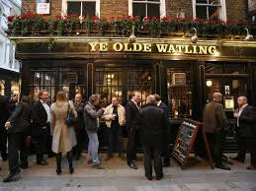
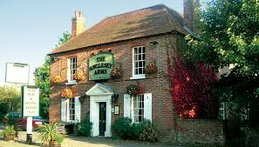
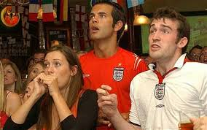
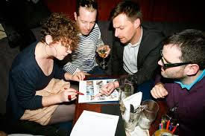
The English Pub
If invited, then go….an important part of social and after-work culture (subject to drink/drive laws). Each person takes it in turn to buy a round of drinks. Non-alcoholic or even tea/coffee is fine.
“It’s not quite like relaxing in your friend’s home, but it quite like being in the home of a friend of a friend, and you may well recognise some of the people there”.
In the pub, everyone is equal. “A good pub is one that welcomes people of all ages….and their dogs.”
Pub culture can include watching the big match together on a large TV screen, pub quiz, snacking/informal dining, restaurant-style meal.
Pubs make great destinations for a walk/drive in the countryside – especially if you go for a typical Sunday roast lunch (best to book). And, on a summer’s day…..sit in the garden.

Slide 10
Meetings
US-style business meeting
To the point
Directed
Decision
Brit-style business meeting
Wider ranging
More “small talk” and humour
May be inconclusive
Strategies for Meeting Management:
Define the meeting:
Operational or Strategic?
Check around individually in advance
Check around individually afterwards
Issue succinct action points and monitor progress.
Notes:
To counterbalance British tendency to vague, indirect language, ensures objectives are agreed SMART - Specific Measurable Achievable Relevant Time-bound
(J F Kennedy “We will put a man on the Moon by the end of the decade, and bring him back alive”)
William Montgomery - TEN
Meetings can easily get out of hand, with people wandering off on tangents or giving long speeches. How can you keep meetings focused without being a taskmaster or squashing creativity?
1. Beforehand, make the meeting purpose clear and send out an agenda. Also consider sending a list of things that won’t be discussed in the meeting.
2. Include only those who are critical to the conversation; meetings can get unmanageable if there are too many people in the room. If you know an attendee tends to monopolise meeting time, talk to him before you get in the room and ask him to keep comments to a minimum to allow others to be heard.
3. End the meeting productively. Discuss next steps, who’s responsible for them, and when they’ll get done. Afterward, send a follow-up e-mail so everyone will remain clear and accountable.

Slide 11
Communication of Instructions
US boss sets objectives
A B C
…..and “fires up” the team!
A B C
Speed in execution
Brit managers often give casual instructions
quite possibly vague, friendly suggestions
maybe posed as questions
Brits like to be “asked not told”
Strategies for understanding:
Speak/read the real message
Read the body language
Use SMART
Notes:
To counterbalance British tendency to vague, indirect language, ensures objectives are agreed SMART - Specific Measurable Achievable Relevant Time-bound
(J F Kennedy “We will put a man on the Moon by the end of the decade, and bring him back alive”)

Slide 12
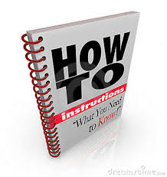
“Persuasion” not “Command”
Language in emails and memos should not be too direct
Presentations: low key with a bit of humour
Set and agree the context – “Why”
Assuming general goodwill, commitment and psychological equality can often work well
Train people to be specific about what they want – “What, where, when”…..but try and leave space for the “How”
Don’t be fooled by understatement or other British English colloquial language habits
Notes:
To counterbalance British tendency to vague, indirect language, ensures objectives are agreed SMART - Specific Measurable Achievable Relevant Time-bound
(J F Kennedy “We will put a man on the Moon by the end of the decade, and bring him back alive”)

Slide 13
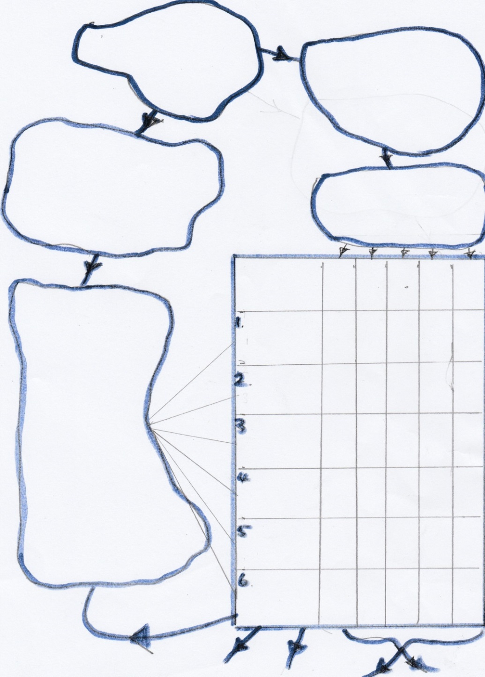
People organised with no gaps and no overlaps”
Mission:
Why are we here?
What do we do?
People:
Who’s on the team?
CEO
Chief Financial Officer
Marketing & Product Director
Sales Director
Operations Director
Objective Function:
How do we do it?
No gaps
No overlaps
For each function, we’ll assign just one to have “Prime” responsibility.
Others may have be designated “C” who have a duty to Contribute or a right to be Consulted
Responsibility Matrix
SD
OpsD
CEO
CFO
MPD
More detail:
(start with a verb)
Below each of these
main headings you
can put more detail.
E.g.
6. Support the Company
6.1 Provide accounting
6.2 Support human resources
6.3 Provide IT
6.4 Provide facilities
Set & monitor Strategy
P
C
C
C
C
“We set & monitor our business objectives and run the company to create products for our selected markets, sell and deliver those products, and provide customer service.”
Scan markets & create products
P
C C
Obtain orders
C P C
Deliver sold products
C P
Provide customer service
C C C P
Iterate as desired at greater levels of detail
Support the Company
P
Detailed Plans & Performance reports
Process Descriptions/Work Instructions
Job Descriptions
Individual objectives
Notes:
The combined cultural characteristics of shared authority, indirectness/some vagueness, individuality, desire for context and complex thinking can lead Brits to extend their role beyond their core responsibilities. Gaps and overlaps can easily occur.
Time spent agreeing processes and then assigning (even enforcing) prime and contributor responsibilities is often worth doing.

Slide 14
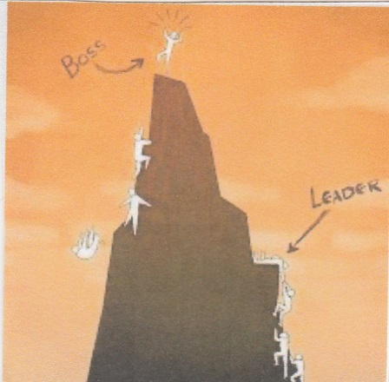
Leadership and teamwork – UK Culture
Good leaders
Intelligent, win-win, adds value, coaches and removes obstacles, principled, truthful, make decisions, gives credit, sticks up for the team, expresses longer term purpose.
Defines mission and individual roles – so as to get the organisation operating without gaps and overlaps (See next slide)
Provides time for one-to-ones. Gives proper feedback. Gives/allows development opportunities
Bad bosses
“I say, you do”, cowardice, “company clone”, decision “drift”, poor example of behaviour, uses people, arrives late for meetings, never available. Focussed on the short term only
Teams
We are individualistic and expect to be accountable. All get chance to talk/have input. If you aren’t a good team player, you’ll be criticised or quietly ignored.
Notes:
Leadership Styles
See diagrams “Casual Leadership” and “Giving orders”
Key characteristics of a good leader in the host culture --describe a good leader using concrete examples
Can be approached. Isn’t always “in meetings”. Seeks informality rather than insisting on rank, but doesn’t detract from dignity of his/her position. Recognises psychological equality, even if there is formal rank inequality.
Respects those around him or her, for their knowledge, experience, diverse perspective. Assumes positive intentions by everyone. Uses “Do you think/what do you think?” questions rather that stating an opinion or idea straight out that may limit further input.
Uses knowledge and experience to ensure all issues are identified before letting people rush off and do things.
Listens to views and seeks to establish the “authority of the situation”. Takes responsibility and decides on the basis of knowledge and a balanced judgement rather than on the basis of formal authority.
Shows that he/she keeps learning -
Provides a good “stakeholder” framework – recognising legitimacy of objectives and encouraging appropriate behaviour amongst shareholders, customers, suppliers, senior management, other employees, departments/divisions, the wider community/the law.
Creates and maintains a good organisation to carry out the organisation’s work without gaps or overlaps. Sets SMART objectives and then monitors them.
Concentrates on direction and objectives (where, what and why”), resources, putting the right people in the right jobs and creating the political space that will allow things to happen .
Tries to let subordinates decide on the “how”, though is ready with ideas. Works hard for subordinates to remove obstacles to achieving success. This is “empowering” behaviour, but that is a buzzword to be avoided.
Rewards the good, is seen to punishes the bad. Catches people doing good things and tells others – inside and outside the organisation.
Makes people talk to each other.
Approachable. Friendly but dignified. Good at stakeholder management. Recognises psychological equality. Explains and sets objectives “What, why and who”, but doesn’t interfere in “how” .Removes obstacles. Rewards the good and punishes the bad. Isn’t always in meetings
Types of leadership that have proved ineffective in the host culture
“I think. You do”.
“Because I’m the boss”. (Though it can be said in fun!)
“We’ve always done it this way”
Cowardice, inconsistency and dishonesty
A manager who constantly recruits clones and/or people less able than himself.

Slide 15
Being a good subordinate – UK Culture
Takes time to understand context. Comes up with ideas
Cooperates with others. Understands that doing your own job is more important than trying to do everyone else’s!
Contributes to the creation of decisions but then says and does as agreed once the decision is made
Understands pressures on boss - knows objectives she/he is trying to achieve
Flags up problems early - no surprises. Delivers on time and within budget - ready to go the extra mile to achieve more than expected
Notes:
Good manager from viewpoint of subordinate:
Allows discussion of bigger picture and methods. Consistent. Clear (SMART)* objectives to counterbalance British/English cultural tendency to make vague “suggestions” which are really orders.
Gives resources and authority to achieve. Helps when asked. Checks around individually well before progress meetings.
Accepts that objectives and tasks may have to be re-negotiated (but will be tough when they cannot be changed).
Brits don’t like “American style” motivational techniques. People don’t want to be fired up. Manager uses humour instead! Comes to the pub, but doesn’t stay too long.
Good subordinate from viewpoint of manager
After discussion, says and does as agreed. Cooperates with others. Comes up with ideas.
Arrives on time for work and meetings. Delivers on time and within budget. Ready to go the extra mile to achieve more than expected. No surprises
*Specific Measurable Achievable Relevant Time-bound
(J F Kennedy “We will put a man on the Moon by the end of the decade and bring him back alive.”

Slide 16
Selected Resources
www.gov.uk Government websites
www.managers.org.uk Chartered Institute of Management
www.iod.com Institute of Directors
www.bbc.co.uk BBC
The confusing British language – irony and understatement etc
Millennials
Females working in male-dominated environments

Slide 17
Summary
Persuasion culture rather than command culture. We like to ask questions and challenge assumptions. British don’t like to rush into things they prefer a gradual approach, and like to look at creative alternatives.
Brits prefer to avoid conflict. Politeness and “win/win” are appreciated. Lobbying gently in advance is can be helpful. Go to the pub.
Brits are more indirect than, say, Americans or Dutch. We speak a different language. We understate and are usually less noisy. (See accompanying paper)
Many of our processes, government/national organisations are unwieldy – the result of generations of compromise. A good dose of American-style focus and “can do” is often helpful in getting action and clarity, but let people have their say first.
International orientation. We have thirty other countries within 2½ hours flying time of London – and the free time to visit them.

